Slide 1

Using LaTeX and Overleaf

Slide 2

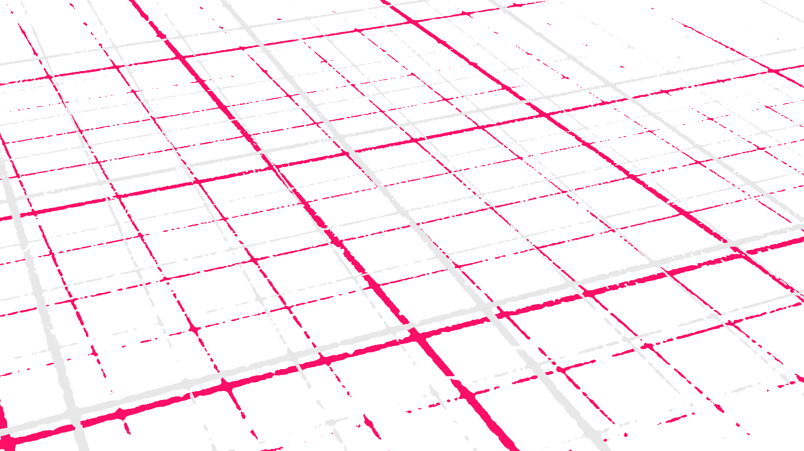

@EdCDCS
For all events, news, and support: cdcs.ed.ac.uk

Slide 3
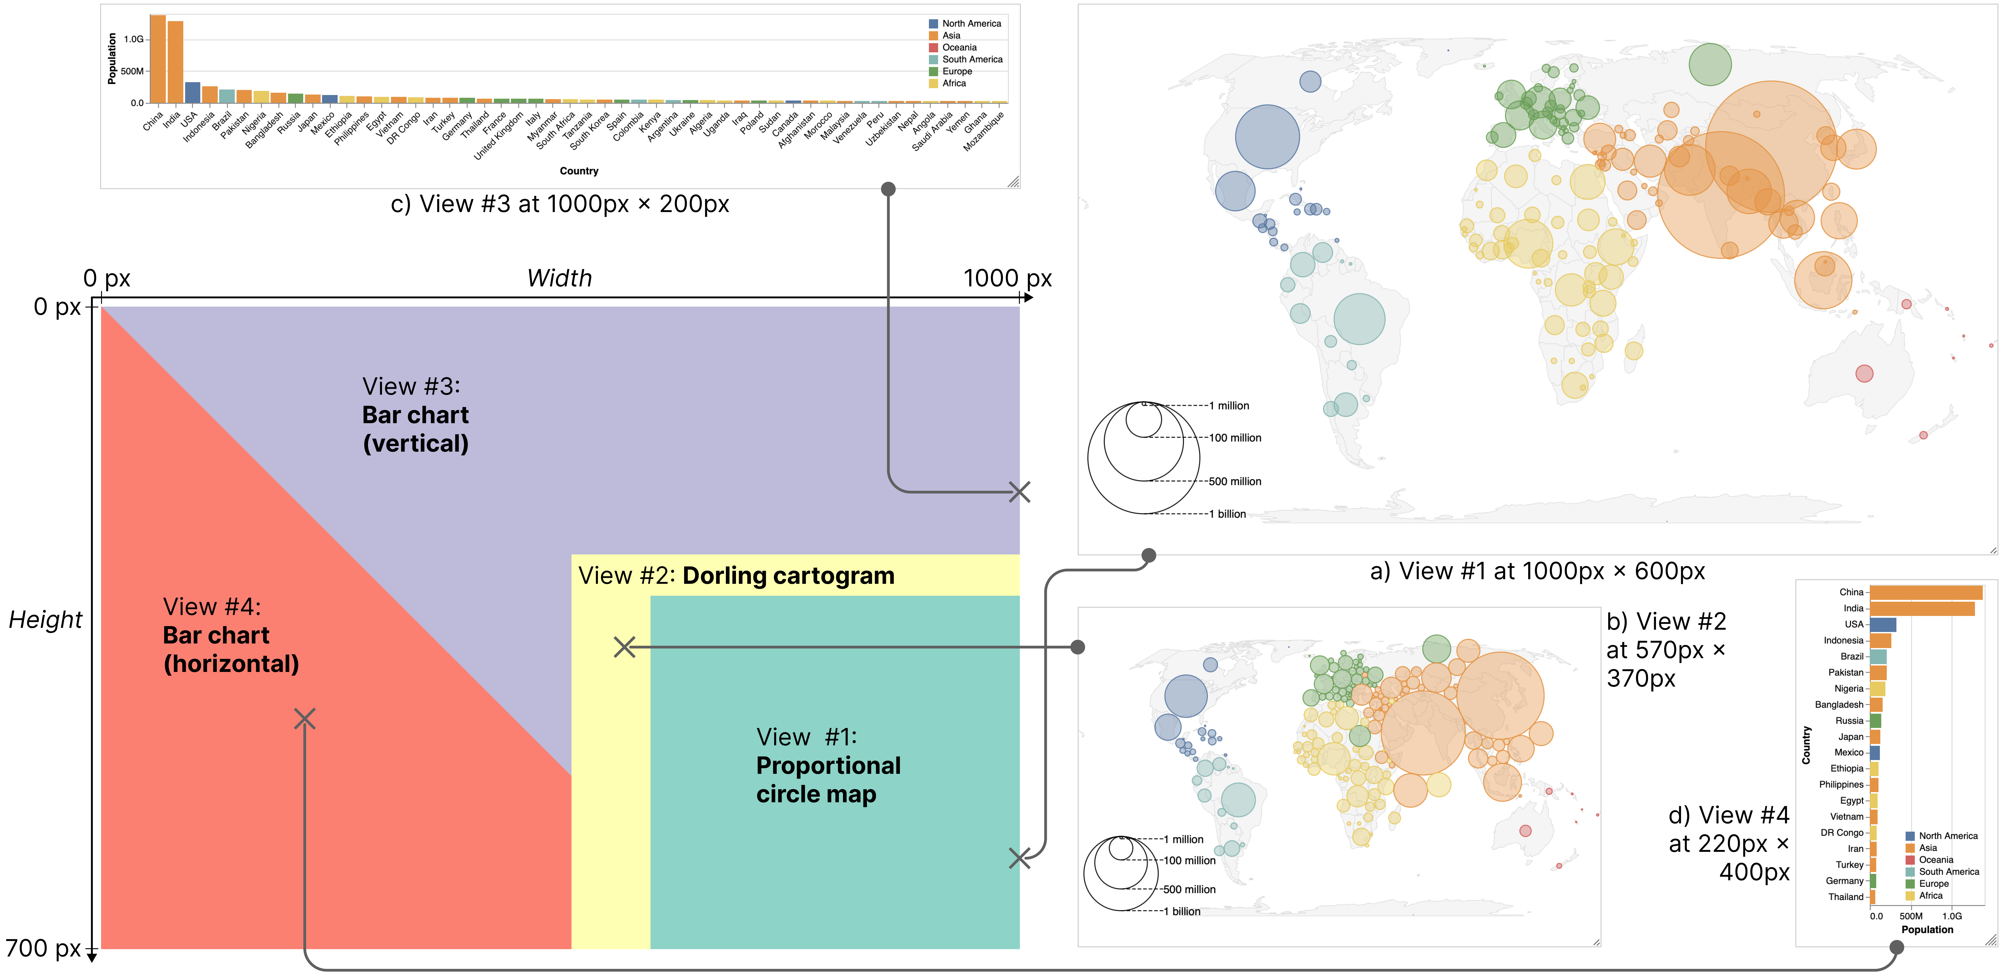
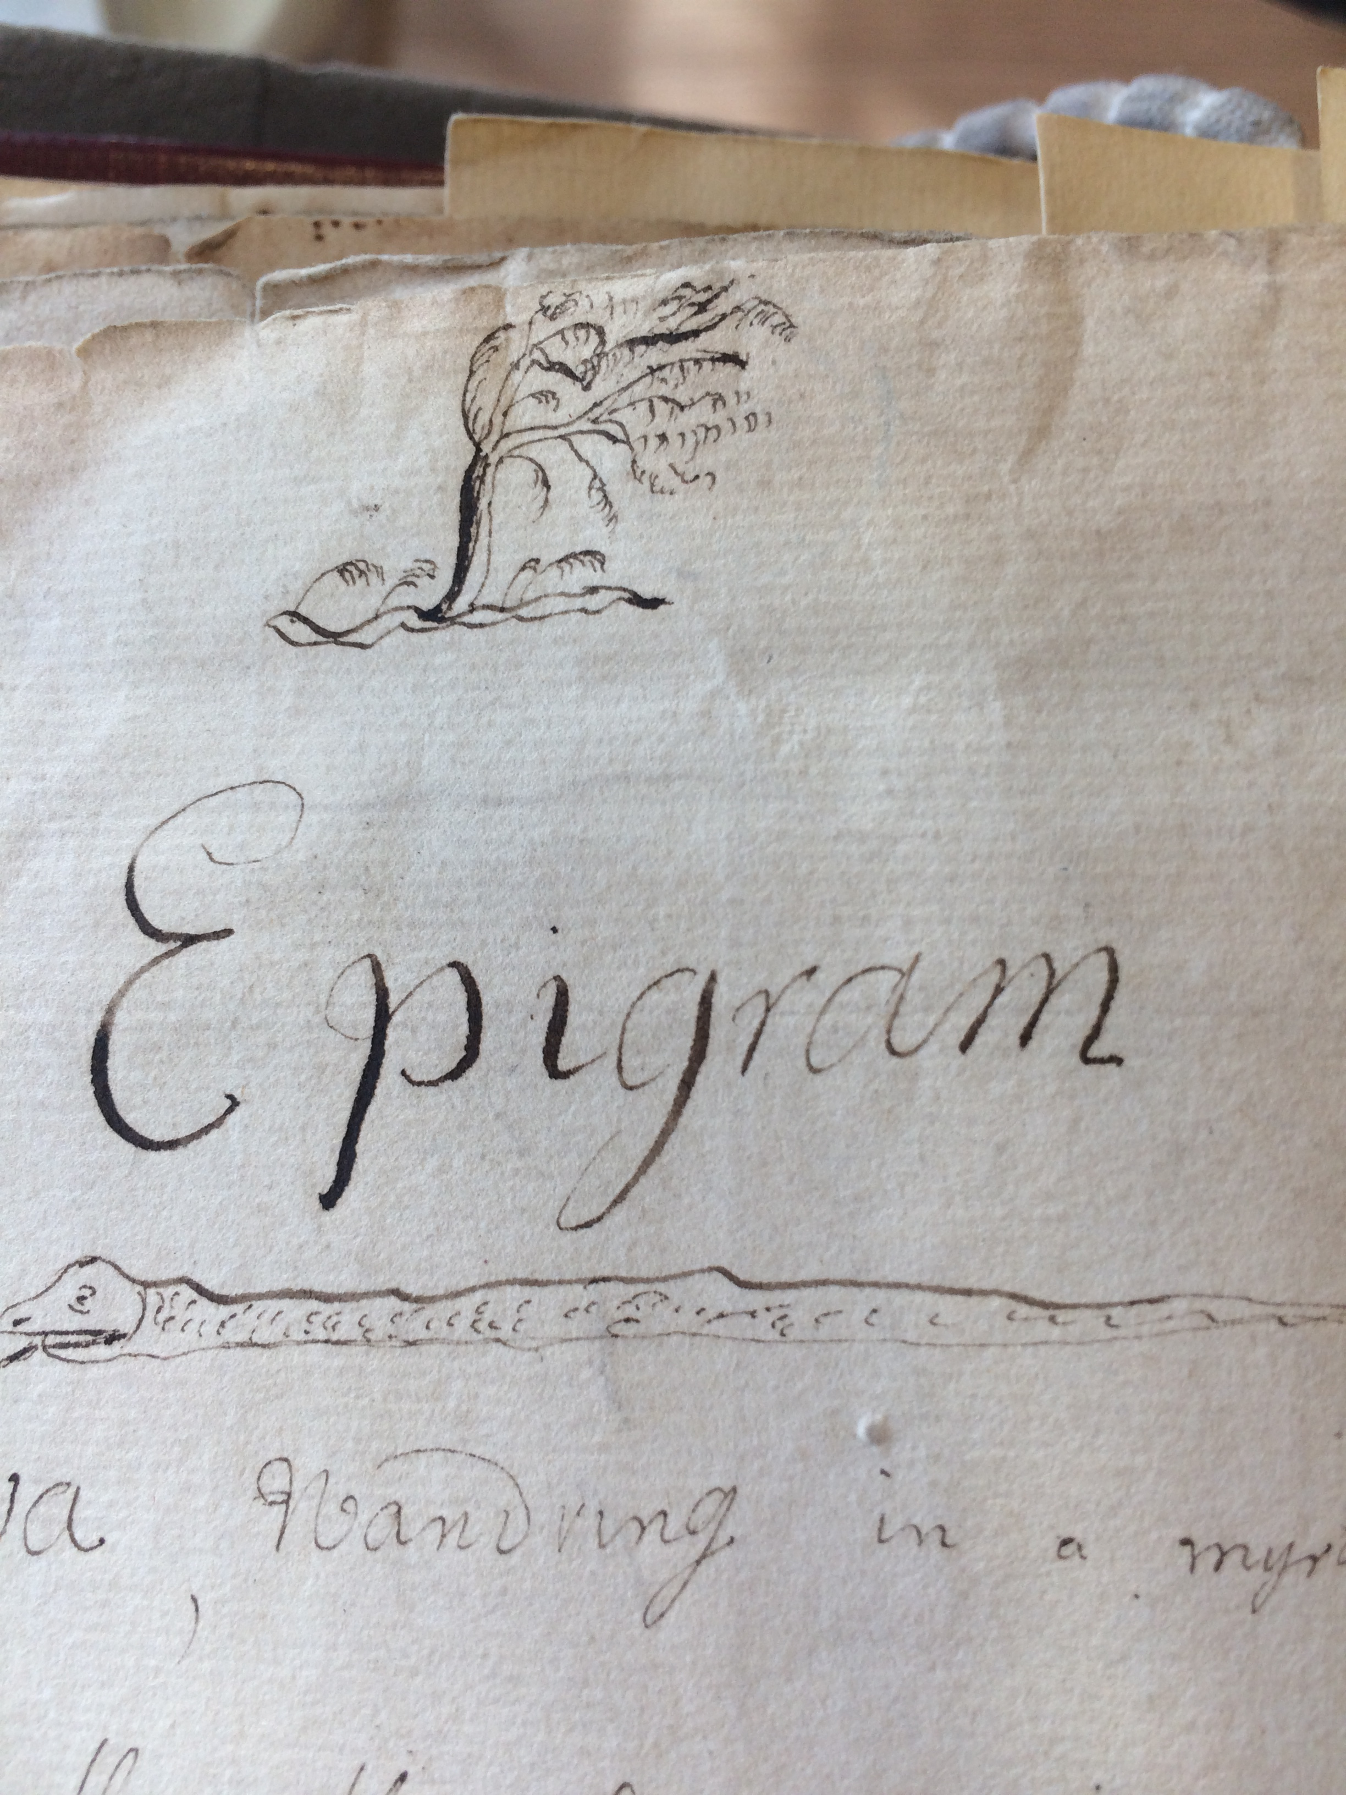
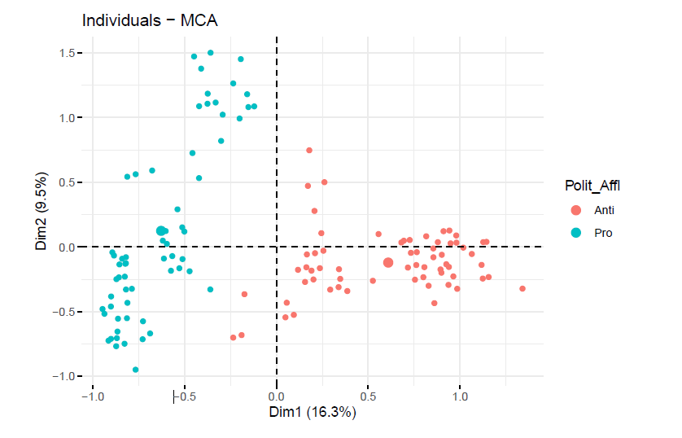
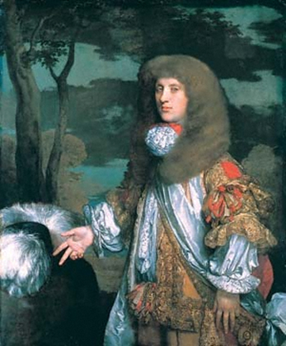
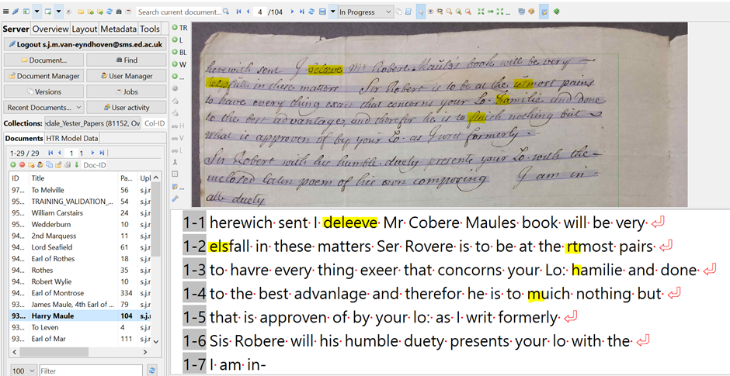

Welcome!
Sarah Schöttler
PhD student in Informatics (UoE) & Visualization Developer
Responsive Geographic Visualization
Training Fellow with DCS
Sarah van Eyndhoven
PhD in Linguistics from UEd
Digitising 18th c. letters
Training fellow with DCS

Slide 4

Week 1: Today's program
What is LaTeX? And what is Overleaf? Why use them?
Setup of a LaTeX document
Basic formatting: Bold, Italics and Underlining
Structuring your document
Text Alignment
Lists
Images
Tables
Find these slides online:
github.com/DCS-training/ LaTeXandOverleaf2023
www.cdcs.ed.ac.uk

Slide 5

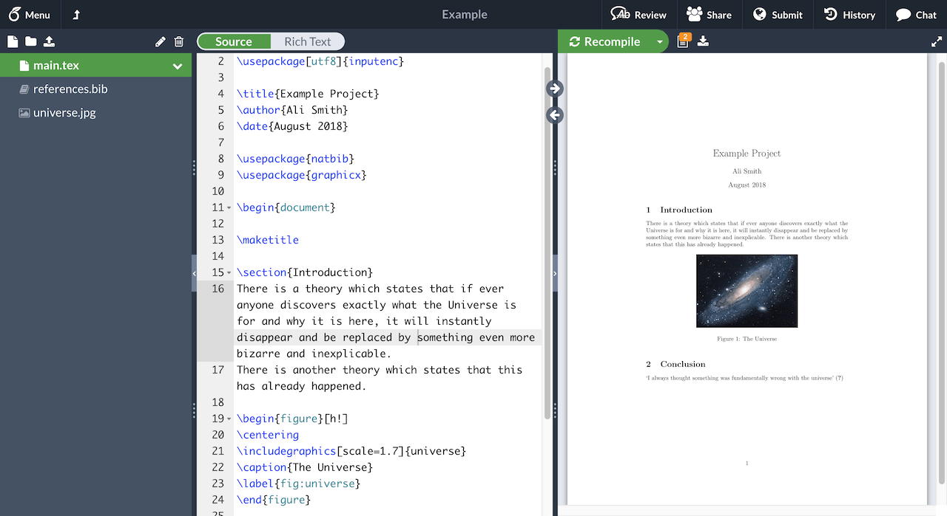
What is LaTeX?
LaTeX (pronounced LAY-tek or LAH-tek) is a tool used to create professional-looking documents. It is based on the WYSIWYM (what you see is what you mean) idea, meaning you only have focus on the contents of your document and the computer will take care of the formatting. Instead of spacing out text on a page to control formatting, as with Microsoft Word or LibreOffice Writer, users can enter plain text and let LaTeX take care of the rest.
www.cdcs.ed.ac.uk

Slide 6

Why learn LaTeX?
LaTeX is used for scientific documents, books, as well as many other forms of publishing.
It does many complicated parts of typesetting automatically, particularly bibliographies and references.
It separates the content of the document from the style. This means that once you have written the content of your document, we can change its appearance with ease.
Many scientific journals create LaTeX templates for submissions. You only need to add your content.
There are hundreds of templates available for everything from CVs to slideshows.
www.cdcs.ed.ac.uk

Slide 7
Reasons not to use LaTeX
Can be challenging to learn, especially for non-programmers – it is a different typesetting paradigm compared to Word
Some journals or your supervisor/collaborators want .docx (Word) files
You might not have complex formatting requirements
www.cdcs.ed.ac.uk

Slide 8
Overleaf
Online platform to author and collaborate on LaTeX documents
Real-time collaborative editing with comments & tracked changes
Basic use is free; pro version is free with UoE email

Slide 9

Advantages of Overleaf
Easier than installing a LaTeX editor on your computer
no need to deal with updates, package installation, installation issues
easy to work on different devices
Many features that make using LaTeX easier:
rich text editor
autocomplete
automatic table creation
and many more
Collaboration features
GitHub integration
Direct submission to some journals

Slide 10
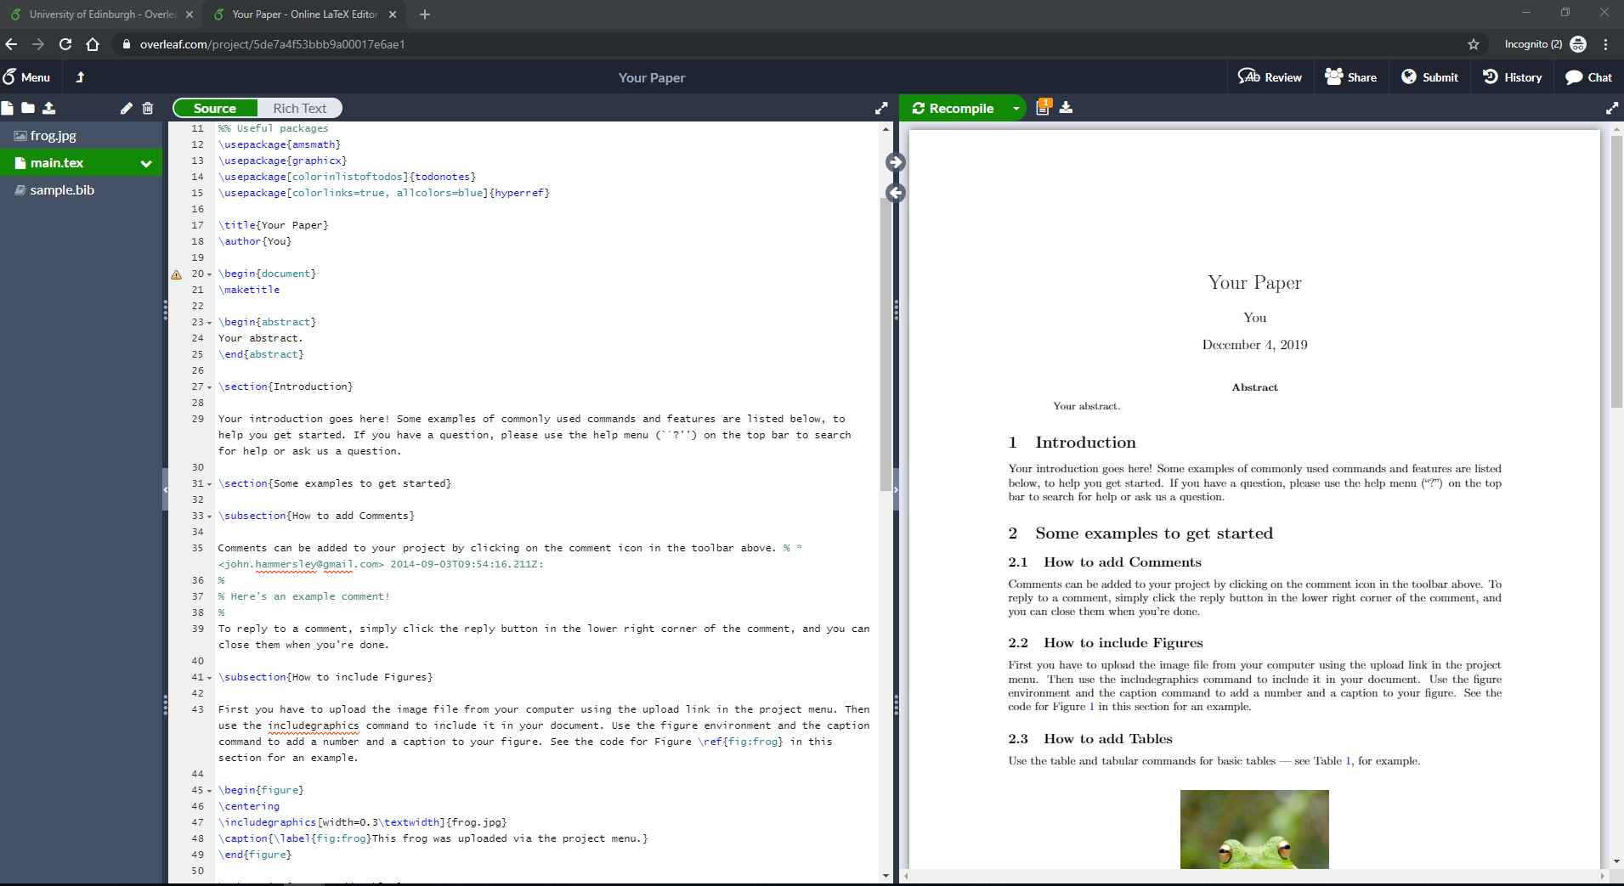
The Overleaf Interface
LaTeX
Compiled PDF
Files/ folders

Slide 11
Anatomy of a LaTeX document
.tex file(s) – contain content/text/commands
this is where your writing goes
.bib file(s) – contain your bibliography entries
different ways of generating these – we will learn about this next week!
Image files added to your document (.png, .jpg, .pdf)
Sometimes, especially in templates, .cls, .sty and other files that specify styles, custom commands, bibliography styles, etc.
You don’t need to edit these (and are often not permitted to) if you’re using a template provided by a journal/conference

Slide 12
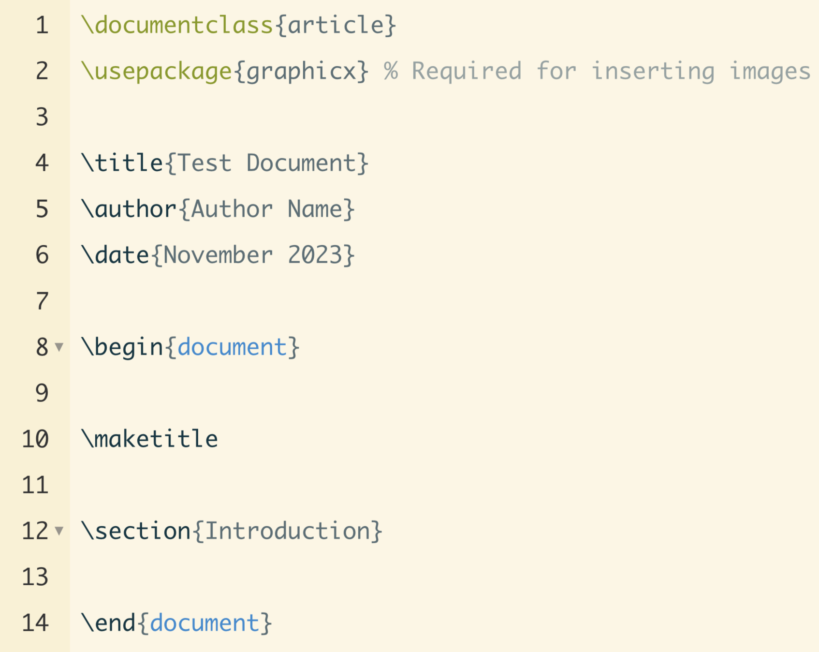
main.tex
Preamble
specify document class, title, author, date, etc.
load and configure packages
can be quite long in templates/complex documents
Document Body
starts with \begin{document}, ends with \end{document}
first command is normally \maketitle
this is where all your content goes

Slide 13


Try it yourselves!
Step by step instructions
Log in / sign up on overleaf.com
Click
Select “Blank project”
Click
Enter your partner’s Overleaf account email and click “share”
The other person will receive an email with a link to the document
Work in pairs
One person creates a new LaTeX document on Overleaf and shares it with the other person
You can now collaborate in this document

Slide 14
LaTeX commands
You use commands to do basically anything in LaTeX: format text, add images, create tables, etc.
Commands typically take this form:
\commandname[config options]{…}
\commandname{…}
optional

Slide 15
Basic Formatting
\textit{everything in here is italic}
Shortcut: Cmd+I (Mac) / Ctrl+I (Windows)
\textbf{everything in here is bold}
Shortcut: Cmd+B (Mac) / Ctrl+B (Windows)
\underline{everything in here is underlined}
https://www.overleaf.com/learn/latex/Bold%2C_italics_and_underlining

Slide 16
Structuring Your Document
-1 | \part{part}
0 | \chapter{chapter}
1 | \section{section}
2 | \subsection{subsection}
3 | \subsubsection{subsubsection}
4 | \paragraph{paragraph}
5 | \subparagraph{subparagraph}
these are only available in long document types: report/book
this is typically the top level you start with
https://www.overleaf.com/learn/latex/Sections_and_chapters

Slide 17
Comments
Use the percent sign % to mark the start of a comment
Comments are ignored for creating the final document
Examples:
% All of this is a comment and will not be included.
\textbf{some bold text} % Only this part after the percent sign is a comment, the start of the line gets included.

Slide 18
LaTeX Environments
Similar to commands, but for longer/more complex pieces of content
Can contain additional commands
Take the following format:
\begin{environment}
…
\end{environment}
You already know the document environment

Slide 19
Text Alignment
Commands
Environment
\raggedright
Everything following this command will be left-aligned (“ragged right”) until you change it again.
\raggedleft
Everything following this command will be right-aligned (“ragged left”) until you change it again.
\centering
Everything following this command will be centered until you change it again.
\begin{flushleft}
Everything in here is left-aligned. Most things are left-aligned by default so you’ll rarely need this.
\end{flushleft}
\begin{flushright}
This is all right-aligned.
\end{flushright}
\begin{center}
This is all centered.
\end{center}
https://www.overleaf.com/learn/latex/Text_alignment

Slide 20
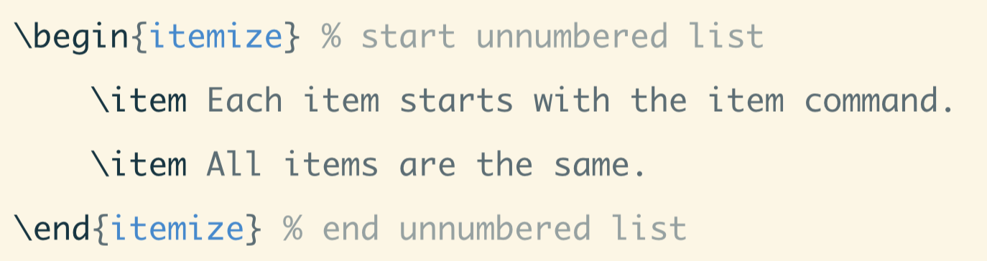
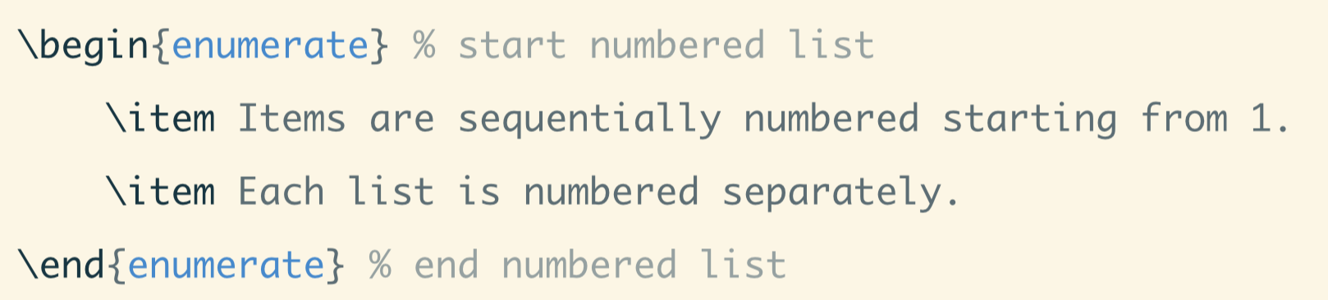
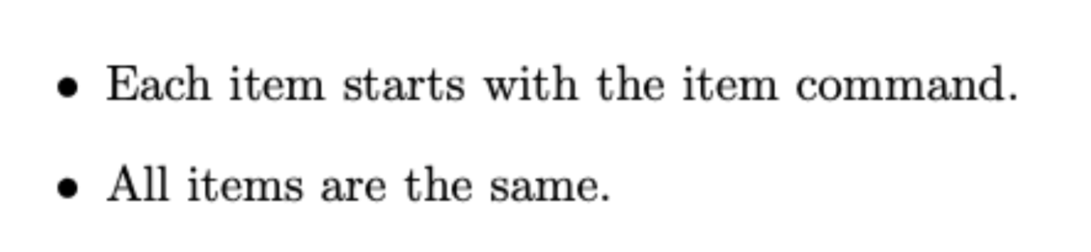
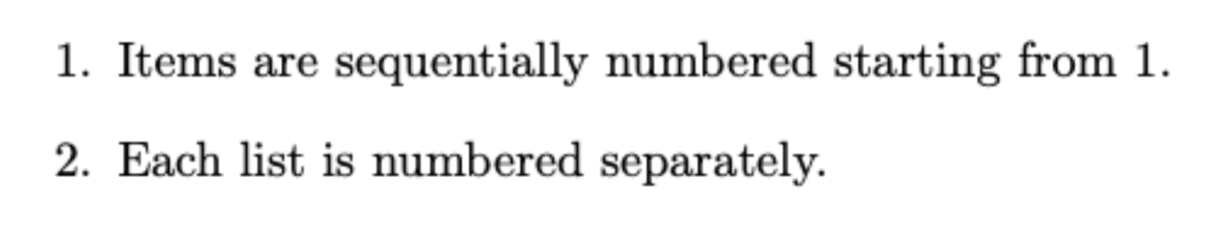
Lists
Bulleted lists
Numbered lists

Slide 21
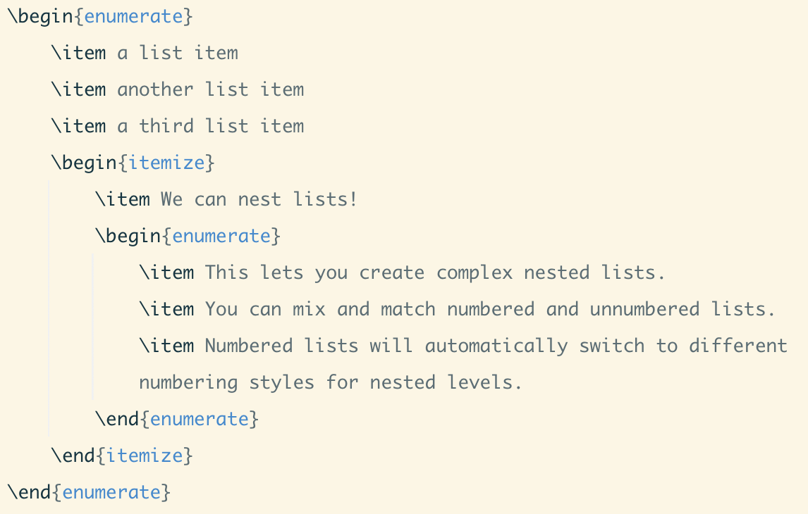
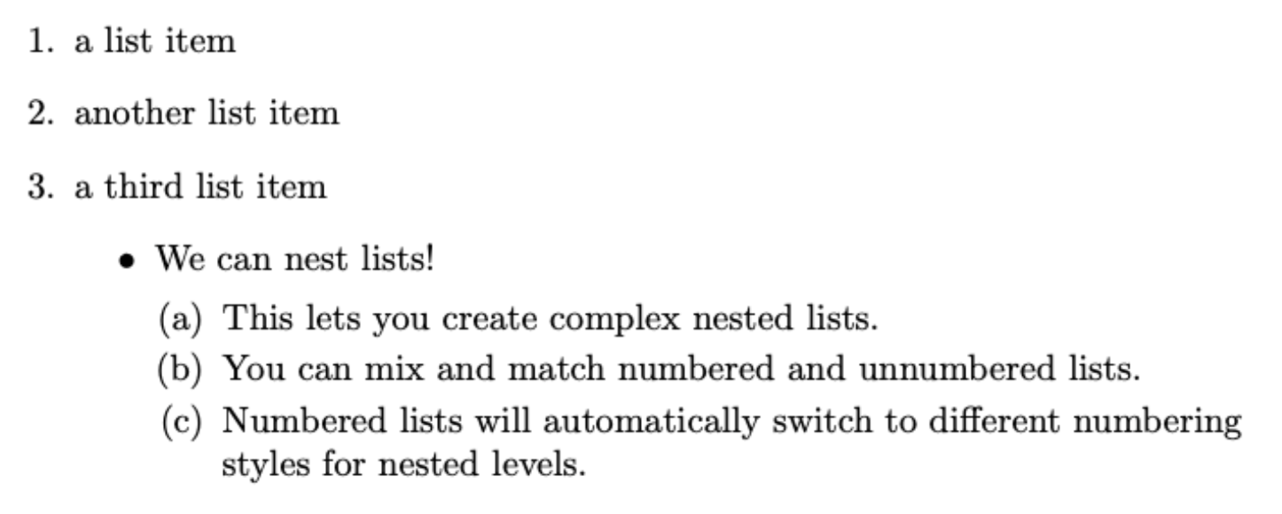
Nested Lists
You can nest lists by including additional itemize or enumerate environments within a list.
You can mix and match numbered and unnumbered lists.

Slide 22
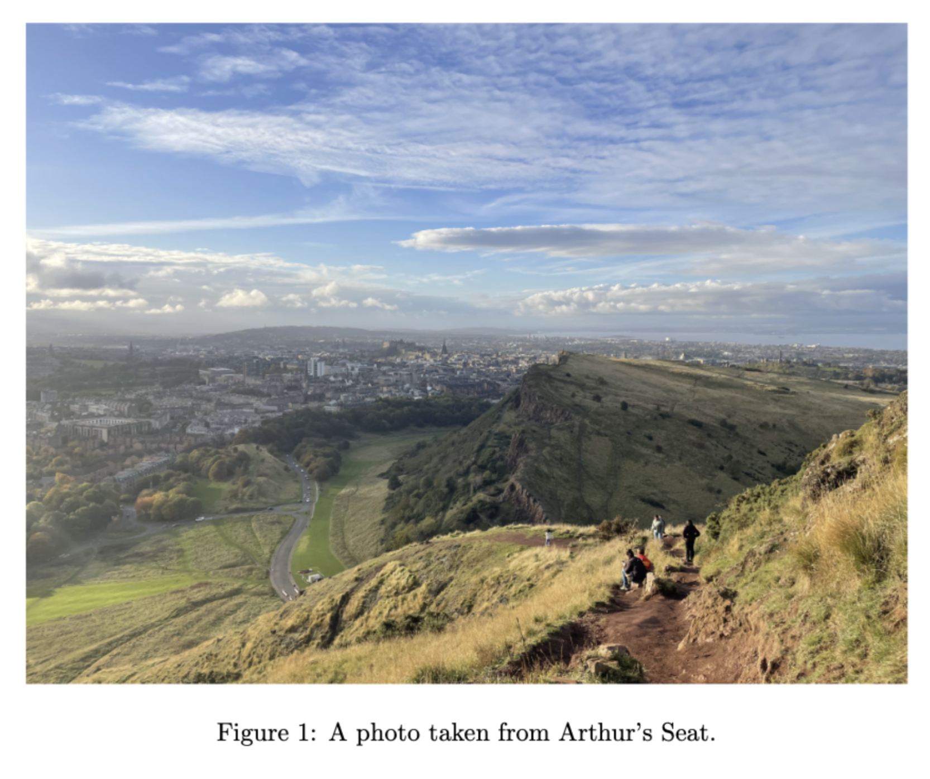
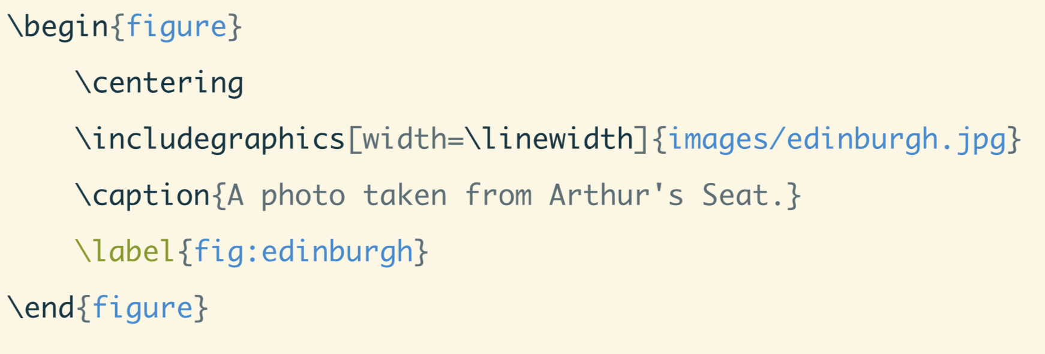
Adding Images
Requires graphicx package: \usepackage{graphicx}
imported by default in new Overleaf documents & most templates
Warning – do not google “Latex images” 🥲

Slide 23

Adding Images
Image folder/location
Can set a default folder in the preamble using \graphicspath
Overleaf autocompletes image paths so this is not really necessary
Changing image size
By default, images scale to the size you upload (incl. going off the page)
Image height or width can be scaled in units (px, cm, etc.) or relative to the document using \linewidth, \textwidth or \columnwidth

Slide 24

Adding Images
Controlling image location
By default, LaTeX inserts your figure close to where you placed it, but determines the “best” location according to its layout parameters
If you don’t like where a figure is placed/need more control, try adding one or more specifiers:
.
Specifier | Permission
h | Place the float here, i.e., approximately at the same point it occurs in the source text (however, not exactly at the spot)
t | Position at the top of the page.
b | Position at the bottom of the page.
p | Put on a special page for floats only.
! | Override internal parameters LaTeX uses for determining "good" float positions.
H | Places the float at precisely the location in the LaTeX code. Requires the float package (\usepackage{float}). This is somewhat equivalent to h!.

Slide 25
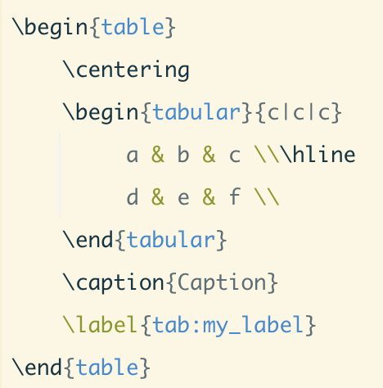
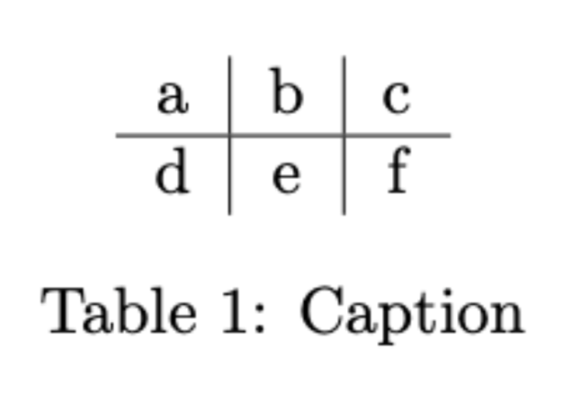
Tables
Overleaf has a table editor in its visual editor
You can also try online table generators; especially when copying your table from e.g. Excel this is nearly always faster than typing them out by hand
https://www.tablesgenerator.com
https://www.latex-tables.com

Slide 26
Additional Materials
Using color (colored and highlighted text): https://www.overleaf.com/learn/latex/Using_colours_in_LaTeX
Using inline images (images with text wrapped around): https://www.overleaf.com/learn/latex/Wrapping_text_around_figures
Using equations/formulas & symbols: https://www.overleaf.com/learn/latex/Mathematical_expressions

Slide 27
Week 2: Today’s program
Chapters
Table of Contents
Citations
References and Bibliography
Play around with your template!

Slide 28

Chapters and Sections
-1 | \part{part}
0 | \chapter{chapter}
1 | \section{section}
2 | \subsection{subsection}
3 | \subsubsection{subsubsection}
4 | \paragraph{paragraph}
5 | \subparagraph{subparagraph}
\chapter{Introduction}
\input{actualchapters/introduction}
\label{Introduction}
\chapter{Literature Review}
\input{actualchapters/Chapter 2}
\label{Literature Review}
\section{Historical Developments}
Label{Section: Hist Dev}

Slide 29
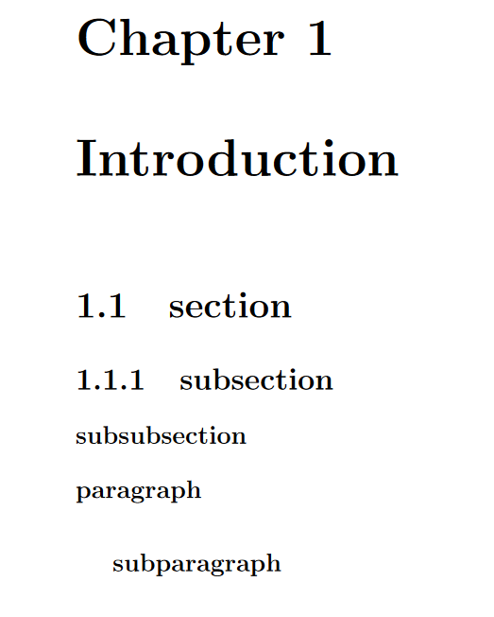
Chapters and Sections

Slide 30
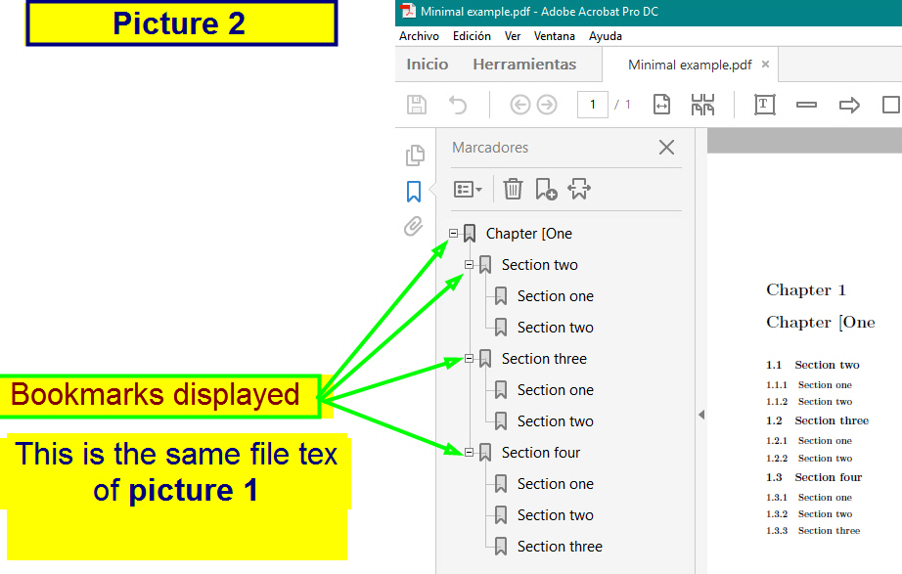
Table of Contents
call the TOC
\tableofcontents
set level of counting for table of contents
\setcounter{tocdepth}{3}
how deep to display in toc
\setcounter{secnumdepth}{3}
add for any chapter not numbered. This is to
have a stand-alone chapter not within in the toc
\addcontentsline{toc}{chapter}{Abstract}
add bookmark
\usepackage{bookmark}

Slide 31
References
.BIB example
@book{Croom2011,
address = {Cambridge},
author = {Croom, Alexandra},
publisher = {The History Press},
title = {{Running the Roman home}},
year = {2011}
}
BibTeX the file format vs BibTeX the software tool
“BibTeX” is both used to refer to a reference management package and to the file format used by this software (i.e. a .bib file)
Bibtex and Biber are external programs that process bibliography information and act (roughly) as the interface between your .bib file and your LaTeX document.
Programmes such as Zotero or Mendeley tend to use bibtex o
to create .bib files

Slide 32
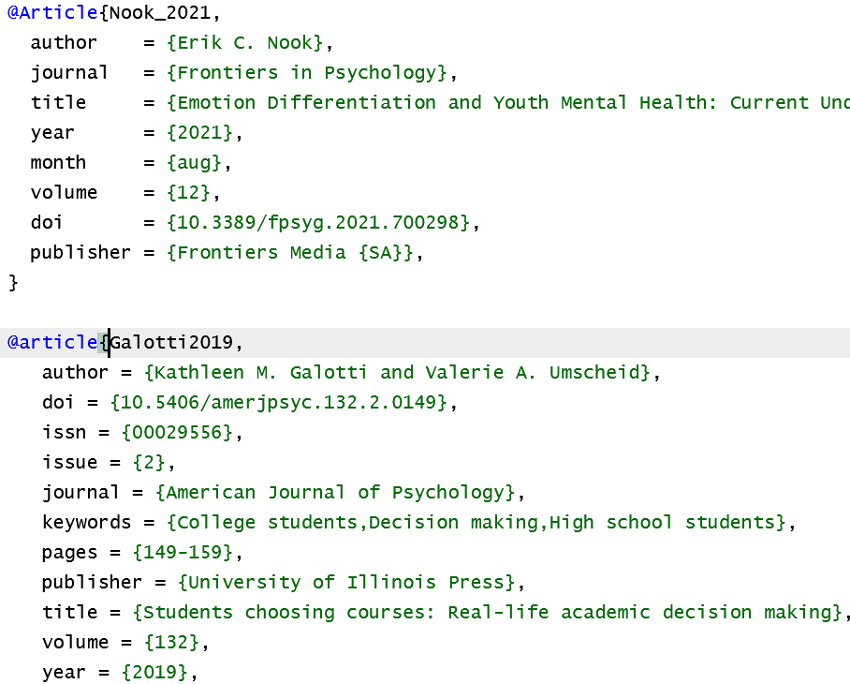

References
There are a number of different packages in LaTex that format citations and bibliographies, including Biblatex, Bibtex and Natbib
To cite references in Latex, you need a bibliography file. This is a .bib file we need to provide ourselves
Reference management software such as Zotero, Mendeley etc can create .bib files
You can upload these to Overleaf or sync your desktop app with Overleaf to continually update it as you go

Slide 33
Cross referencing
Cross Ref Chapter
\ref{Chapter:Introduction}
Cross Ref Figure
\ref{Figure:id}
Cross Ref Table
\ref{Table:id}
Cross referencing will make the reference update automatically if you add more images or equation before in the chapter!

Slide 34
References
Natbib: For Traditional and Flexible Citation Styles
package designed for flexibility in citation style
supports both author-year and numerical citations
customization to match a variety of citation formats
simple to use and is compatible with most LaTeX documents
BUT: functionality is relatively basic - for more complex bibliography requirements, you might need to look elsewhere
Bibtex: For Ease and Compatibility
main strength = compatibility and ease of use
Many academic journals accept Bibtex
Extensive online documentation
BUT: doesn't handle Unicode well, so tricky for non-English languages
Biblatex: For Advanced and Multilingual Needs
modern package that provides more advanced features than Natbib or Bibtex
handles Unicode well
supports a wider range of citation styles
allows for more customization
BUT: requires the use of Biber as the backend for sorting and processing bibliographic data

Slide 35
References
Summary?
Natbib is great for simple documents requiring traditional citation styles
Bibtex is an excellent choice for compatibility and ease of use, especially when
writing for journals that support Bibtex format.
Biblatex is the best choice for complex or multilingual documents, or if you need
more customisation in your citations

Slide 36
Natbib
Today we will focus on using Natbib (most common in Humanities)
Commands:
\usepackage{natbib} % use Natbib citation package
\setcitestyle{aysep={,}} % Set cite style, and put comma between author and year (can also be space ; : etc)
\setcitestyle{notesep={: }} % Put colon between author/year and info in 'note' field (usually pg #)
\setcitestyle{yysep={,} % Separator between years with common author
\bibliography{References.bib} % Give the name of the bibliography file
\bibliographystyle{apalike} % Style of biblio and citation
\addcontentsline{toc}{chapter}{Bibliography} % Add biblio to table of contents
\chapter*{Bibliography} % Call it bibliography rather than references
\markboth{Bibliography}{Bibliography} % Add biblio in header

Slide 37
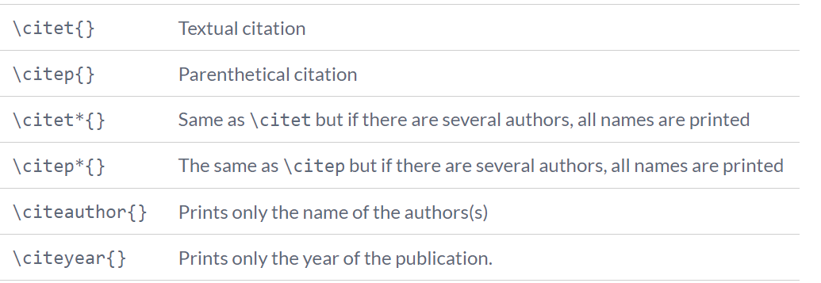
Citations
Natbib options

Slide 38
Citations
Citing in-text
\citet{} - see for example Brown et al., 1987
\citet*{} - see for example Brown, Levinson and Gunther, 1987
\citep{} - (Macinnes, 2007) OR with \setcitestyle{authoryear, open={(},close={)} and \cite{}
\citep*{} - (Johnson, Smith & Colley, 2007)
\citep[272]{} - (Macinnes, 2007: 272)
\citep[see][272]{} - (see Macinnes, 2007: 272)
(\citealp[]{}; \citealp[]{}) - (McMillan, 2005: 34; Macinnes 2007: 294)
\citeyear or \citeyearpar{} - as Cruickshank (2012) argues...
\citeauthor{} - indeed, Cruickshank suggested that..
More on Citation styles
https://www.overleaf.com/learn/latex/Biblatex_citation_styles

Slide 39
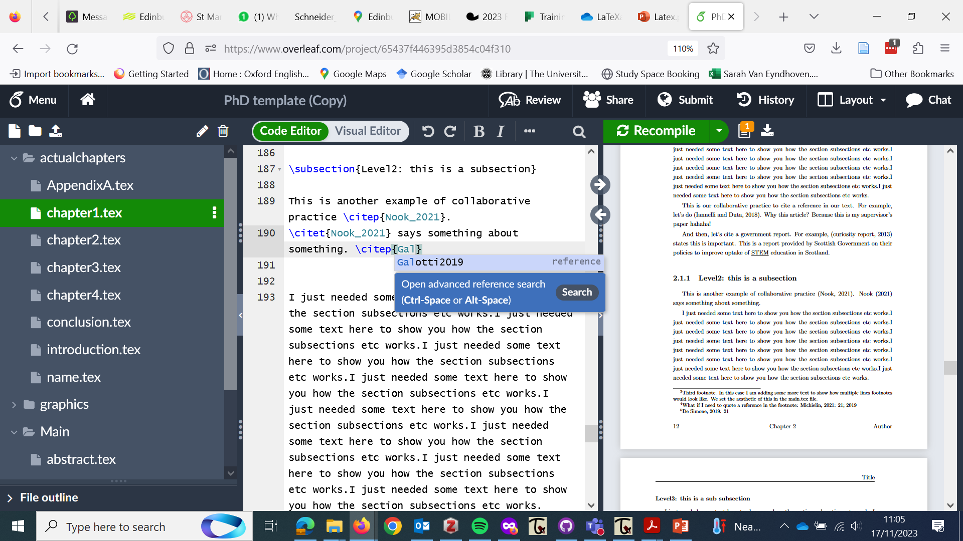
Citations
Your .bib file will assign a shorthand name to each reference, e.g. Galotti2019. This is usually based off the author of the text.
Normally, you can just start typing the name of the author, e.g. "Galo-" and Latex will provide a dropdown box with possible options to choose from, e.g. Galotti2019

Slide 40
Citations: Footnotes
The footnote command is very easy
\footnote{Here goes the text I want in my footnote}
Using footnotes for citations
I'm going to cite someone now\footnote{\citet[21]{Michielin2019}; \citeyear{Binford2021} }
Output: I'm going to cite someone now⁴
⁴Michielin 2019: 21; 2021
If you need ‘ibid’ style citations, the citation style authoryear-ibid or authoryear-icomp (combining compact variant of a-y style (e.g. Defoe, 1995, 1996) and ibid in Biblatex works well for this

Slide 41
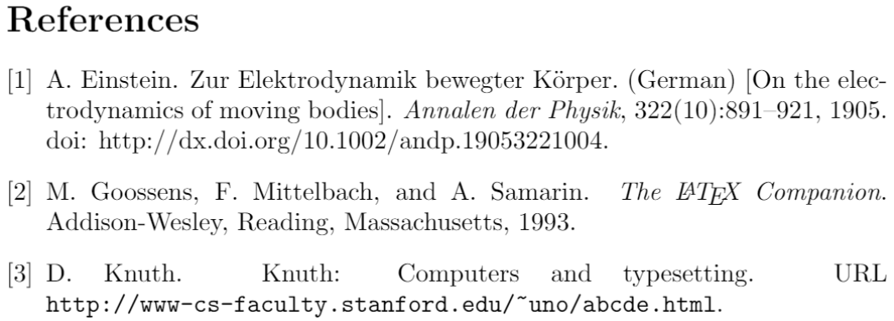
Numerical Citations
\usepackage[square,numbers]{natbib} \bibliographystyle{abbrvnat}
Latex Text:
The Einstein journal paper\citet{einstein}, and the Donald Knuth's website \cite{knuthwebsite}. The \LaTeX\ related items are \cite{latexcompanion,knuthwebsite}.
Output:
The Einstein journal paper [1], and Donald Knuth's website [3]. The Latex related items are [2, 3].

Slide 42
Your turn!
Either open up the PhD template included in the Github depository, or open a template of your own (from a journal, publication, shared document etc.)
Have a play with some of the commands, and wave one of us over if you get stuck
Please ask questions! We are here to help :)

Slide 43
Additional Materials
Importing from R (creating an Rtex file using Knitr): https://www.overleaf.com/learn/latex/Knitr
Import your document from OpenOffice: https://extensions.libreoffice.org/extensions/writer2latex-1/1-6.1

Slide 44
Feedback Form
Please fill out this feedback form to help us improve CDCS courses: https://forms.office.com/r/YYNrqvuNr8
Other interesting courses happening this week
PhD and early career social: https://www.cdcs.ed.ac.uk/events/phd-ecr-social-11-23
CDCS town hall: https://www.cdcs.ed.ac.uk/events/town-hall-autumn-2023
Keyphrase network analysis Master Class: https://www.cdcs.ed.ac.uk/events/masterclass-pedro-jacobetty
Annual Lecture by Mary Flanagan "How to See What's Missing: https://www.cdcs.ed.ac.uk/events/annual-lecture-2023

